Slide 1

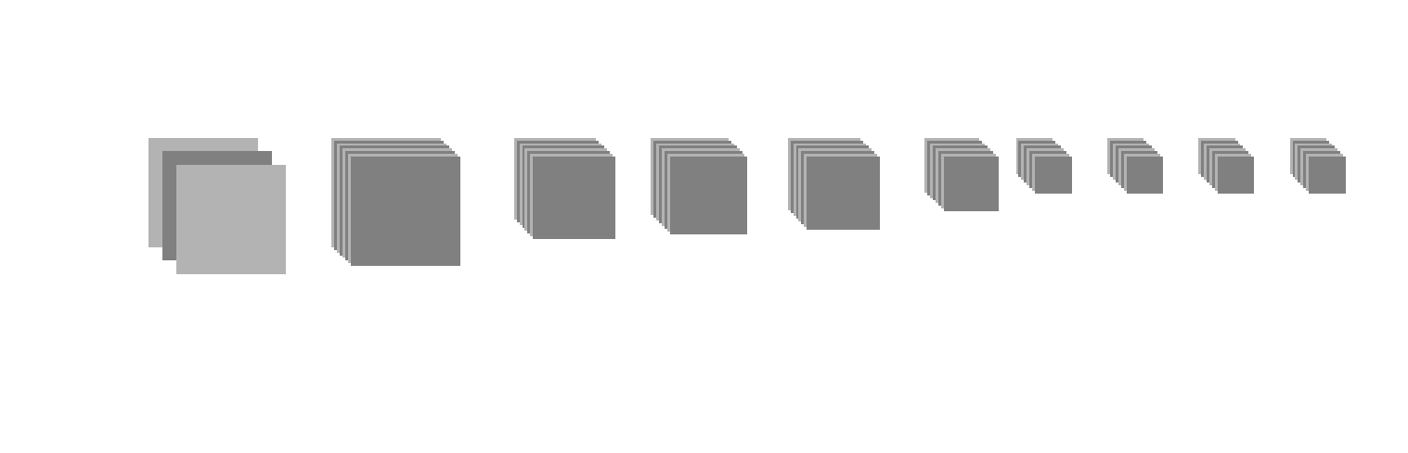
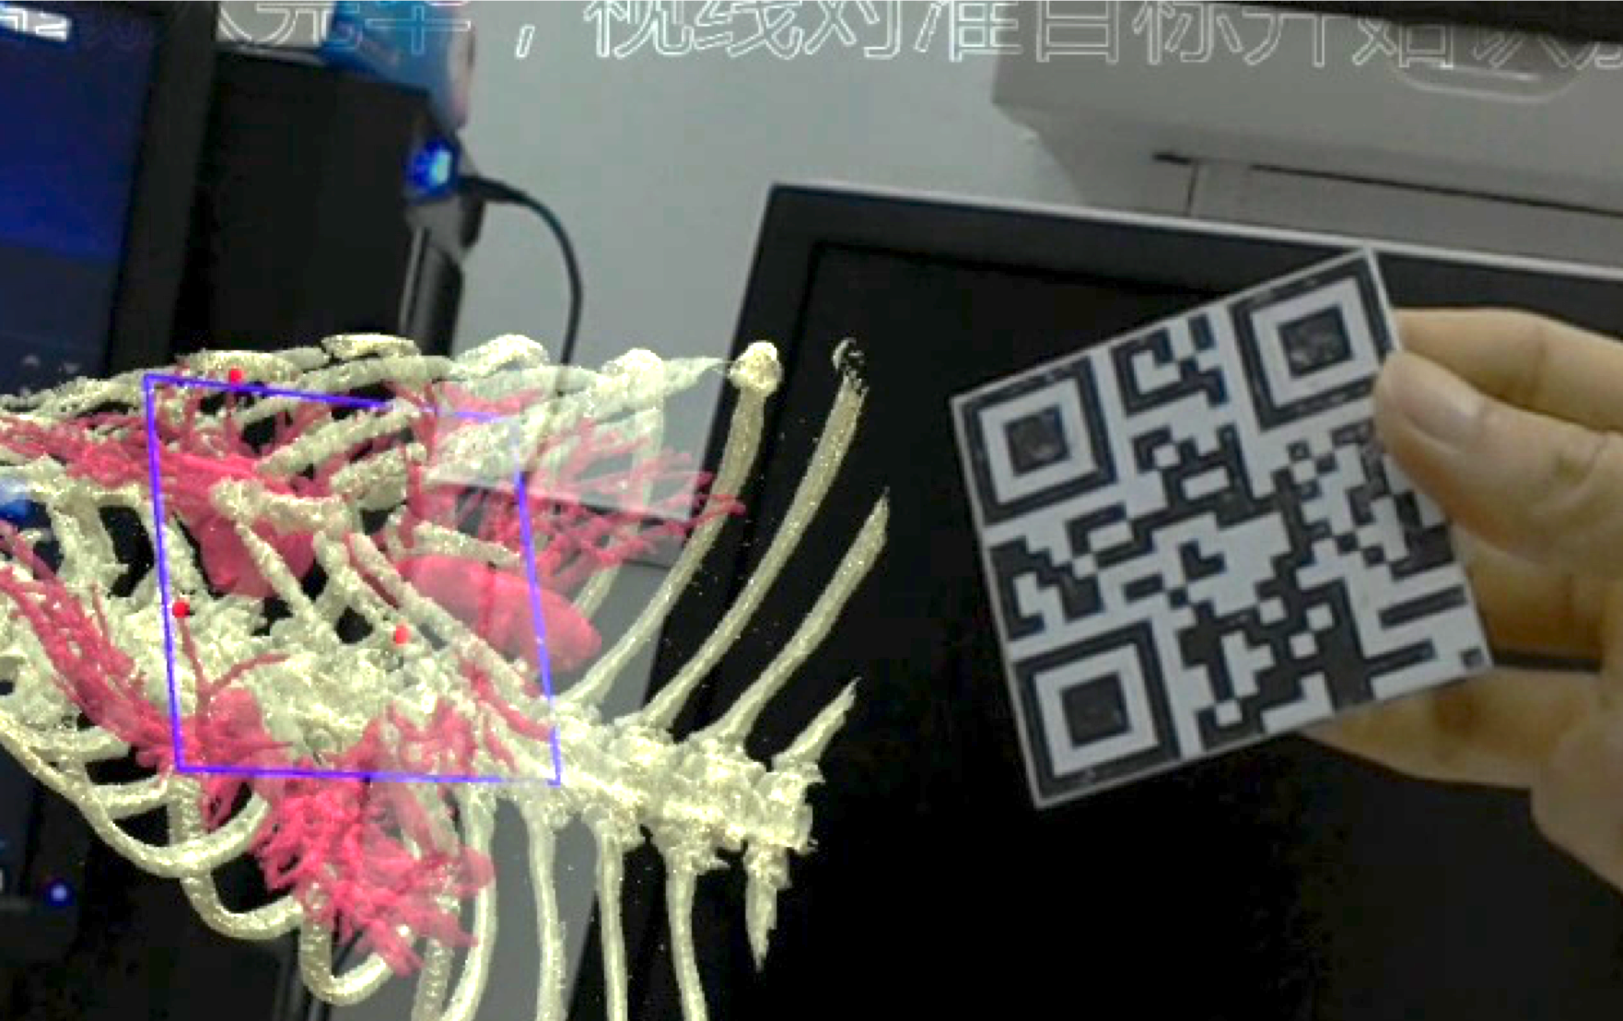

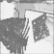
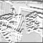
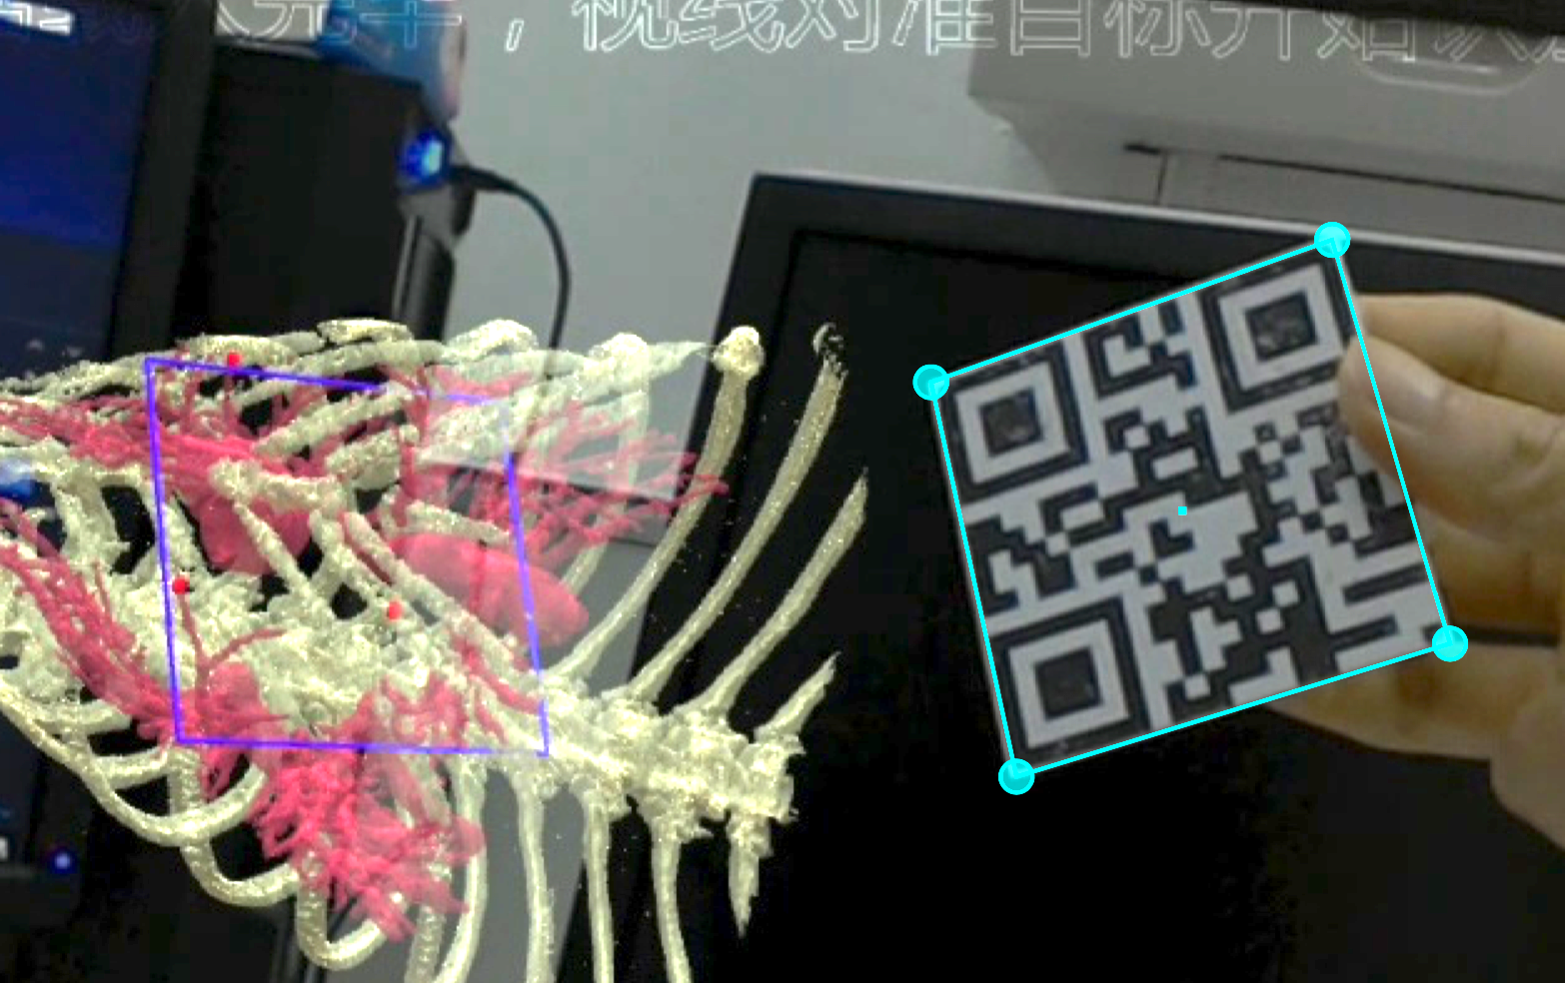
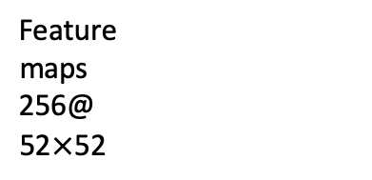
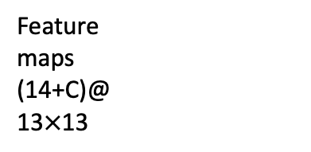
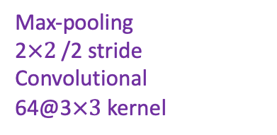
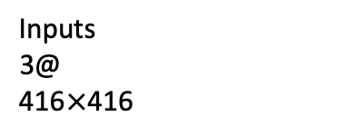
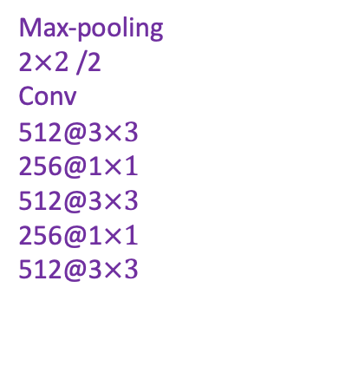
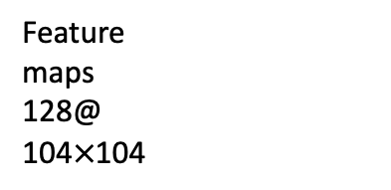
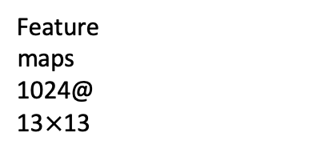
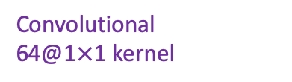
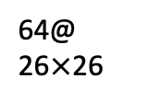
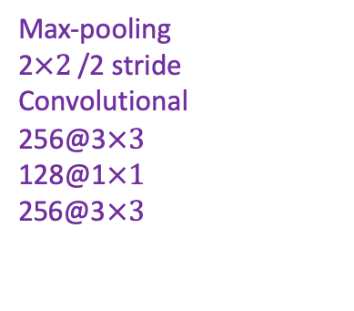
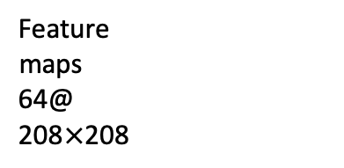
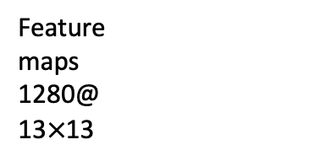
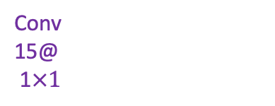

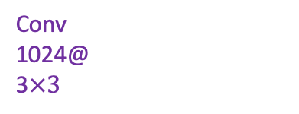
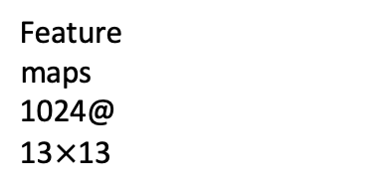
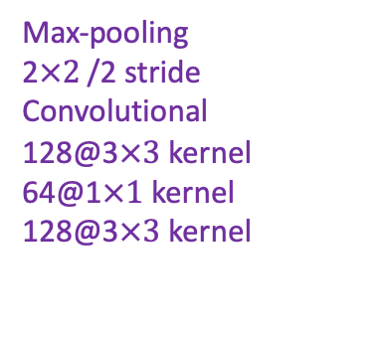
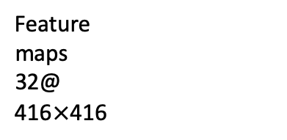
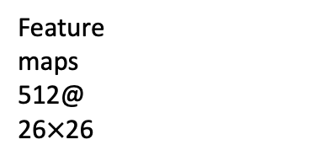
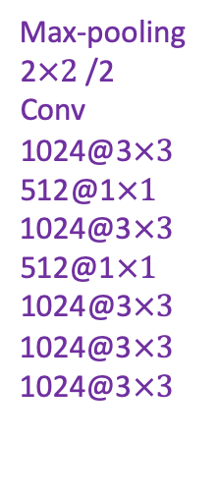
64@
26$×$26
256@
13$×13$
Passthrough layer
Convolutional
64@1$×$1 kernel
Feature
maps
512@
26$×$26
Feature
maps
(14+C)@
13$×$13
Feature
maps
1024@
13$×$13
Feature
maps
1280@
13$×$13
Inputs
3@
416$×$416
Feature
maps
32@
416$×$416
Feature
maps
64@
208$×$208
Feature
maps
128@
104$×$104
Feature
maps
256@
52$×$52
Feature
maps
1024@
13$×$13
Concave
Conv
1024@
3$×3$
Max-pooling
2$×2$ /2
Conv
1024@3$×3$
512@1$×1$
1024@3$×3$
512@1$×1$
1024@3$×3$
1024@3$×3$
1024@3$×3$
Conv
15@
1$×1$
Max-pooling
2$×2$ /2 stride
Convolutional
128@3$×3$kernel
64@1$×1$kernel
128@3$×3$kernel
Max-pooling
2$×2$ /2 stride
Convolutional
256@3$×3$
128@1$×1$
256@3$×3$
Max-pooling
2$×2$ /2
Conv
512@3$×3$
256@1$×1$
512@3$×3$
256@1$×1$
512@3$×3$
Convolutional
32@3$×3$ kernel
Max-pooling
2$×2$ /2 stride
Convolutional
64@3$×3$kernel
Input
Layer 1
Layer 3
Layer 5
Layer 10
Layer 20
Layer 22
Output corners

